Slide 1
Heliophysics Division
Heliophysics AI/ML Ready Data (HARD) Program SOHO/LASCO AI/ML Case Studies
Ekaterina (Katya) Verner, PhD & PMP
Heliophysics Program Scientist
March 25, 2022

Slide 2

Outline
New Heliophysics Artificial Intelligence / Machine Learning (AI/ML) Ready Data (HARD) Program (B.16, 7 slides)
AI/ML Case Study with Amazon Web Services (AWS, 2 slides )
NASA SOHO/LASCO challenge with Topcoder (7 slides)
Conclusion (1 slide)

Slide 3
Heliophysics AI/ML Ready Data (HARD) Program
Create AI/ML ready data sets and products, which allow the use of AI/ML methodologies and approaches to address specific science problems
Cover all R&A elements in Heliophysics
Welcome Cross-functional teams (AI, Heliophysics experts)
Create opportunities for underrepresented and underserved communities to obtain AI skills and to work with data

Slide 4
HARD Key Points
Expected to be useful for various methods and tools and to be stored as AI/ML catalogs and archives for public use
Create “clean” datasets, which might require
Fixing structural errors,
Handling missing data,
Removing non-physical outlier points,
Removing artifacts
Filtering observations
The quality of the data is key to the quality of machine learning algorithms developed from the data. Even simple algorithms can yield important insights.
Important: specific domain expertise/collaboration with the persons responsible for the data quality

Slide 5
Examples of AI/ML Ready Data Activities
Creating a comprehensive set of labeled features from an existing observational data set
Creating AI data science products to advance automated mission operations
Developing general AI/ML data-related methods and approaches applicable to multiple NASA missions
Improving the calibration of data or using new techniques to calibrate data like self-calibration, etc.

Slide 6
Step One: Program Submission
Due October 18th, 2022
Step-1 proposals must include a brief statement (4000-characters) covering:
Science goals, objectives and/or challenges
The methodology to be used, including what data, models, analysis and approach
The relevance to Heliophysics

Slide 7
Step Two: Program Submission
Due January 18, 2023
10-page limit. Must include:
The need for/perceived impact to the state of knowledge in the field
The methodology to be employed in conducting the proposed effort
The relevance of the proposed work to Heliophysics
A general plan of work, the management structure for the proposal personnel
A description of the expected contribution to the proposed effort by the PI and each person
Must demonstrate the potential value of resulting AI/ML-ready data sets or features in the investigation of one or more high-level science goals in the Living With a Star program, the Space Weather program, or from the Heliophysics Decadal survey (Solar and Space Physics: A Science for a Technological Society).

Slide 8
Additional Requirements
All investigations must demonstrate the availability and usability of processed data and that they can be readily fed into analysis algorithms or tools
The final product must:
be available at a standardized level and correspond well to the data collection of the physical system being studied
demonstrate that spurious data and non-physical values can be corrected or identified
available in a way that is easily read into an AI algorithm (e.g., GitHub, Keras, PyTorch)
Any products obtained through a HARD-funded program should be made publicly available in a prompt manner

Slide 9
Dual-Anonymous Peer Review
Proposals may not include language that identifies the names of investigators or their institutions, as discussed in the Guidelines for Anonymous Proposals
PIs are required to upload along with the proposal an additional "Expertise and Resource – Not Anonymized" PDF through NSPIRES
SMD reserves the right to return without review proposals that are particularly egregious in terms of the identification of the proposing team

Slide 10
AI/ML, SOHO/LASCO/C2 and Comets

Slide 11
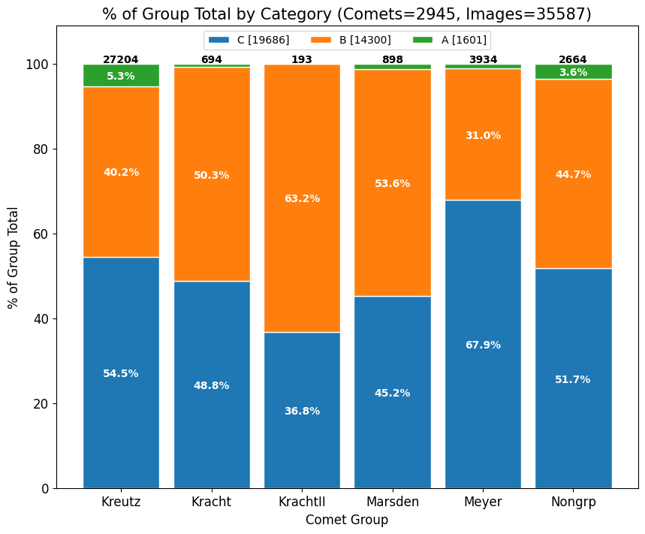
Number of individual SOHO/LASCO/C2 images by comet family & brightness category
A total of 35,587 images spread over 2,945 comets
All the comet populations (see x-axis labels) have a very approximately even split of Category B and C brightness, with just a few percent in the super-bright category A
Overall, there are slightly more Cat C than Cat B images (19686 v’s 14300).
The data set it naturally quite well set up for this challenge.
Credit: Karl Battams, NRL

Slide 12
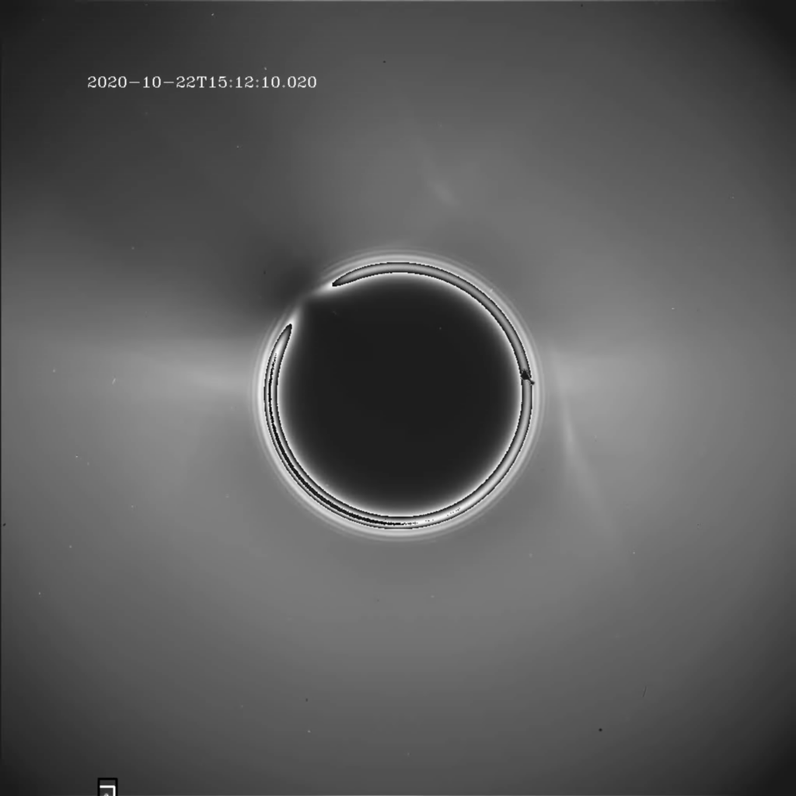
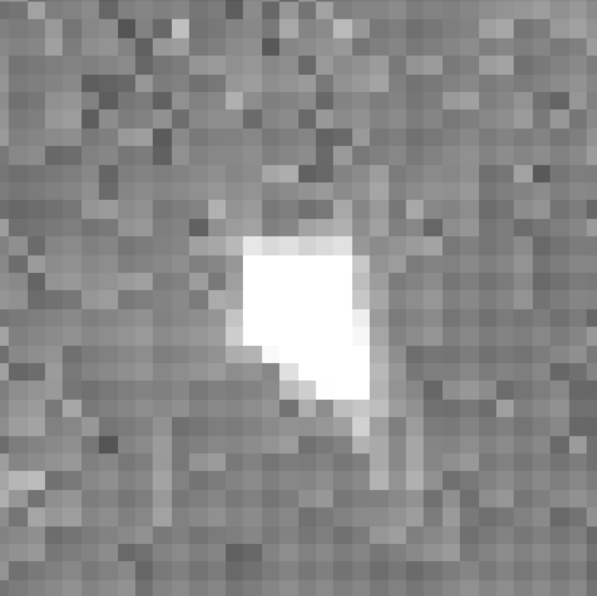
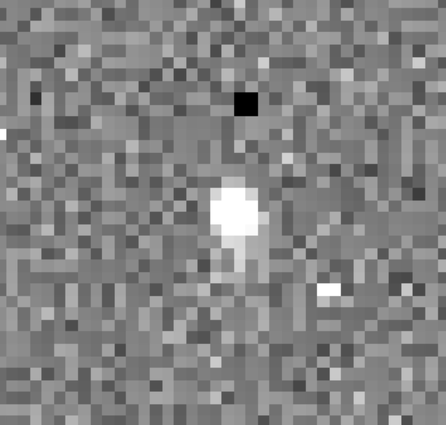

AWS Effort: AI/ML Comet Identification (with IOU)
Cat. A
Cat. B
Cat. C
Vmag > 5.0
5.0 > Vmag > 8.0
Vmag < 8.0
Separated into brightness categories A, B and C based on average visual magnitude 4.5% A, 40% B, 55.5% C
Credit: Yigit Aytac (AWS)
Notes:
Credit to Yigit Aytac. In object detection there is something called Intersection Over Union (IOU) which determines if the detection is accurate. For example, the 25% IOU threshold means that if prediction and the ground truth not overlapping more than 25%, then this would be a false positive prediction. The existing model is not really perfect in that sense. That 100 % is not entirely accurate.

Slide 13
Open Science
NASA@WORK is a central hub for ideas and collaboration. Employees and contractors across the agency can solve problems and share their expertise right from their computers. Collaboration is fundamental to NASA's success and finding solutions to some of our biggest challenges; NASA@WORK makes that just a little easier.
2 ideas out of 14 were funded
Reference:
https://science.nasa.gov/open-science-overview https://science.nasa.gov/earth-science/earth-data https://earthdata.nasa.gov/esds
https://nasa-at-work.nasa.gov/a/index

Slide 14
SOHO/LASCO Open Science Challenge
Objective:
Build AI/ML-based approach to help identify the faintest noise-level comets by reducing background noise in the SOHO/LASCO/C2 data. LASCO continues to discover ~ 10-20 comets/month that can be used for testing/validation once contest ends.
TopCoder will develop a set of challenges with ideation first approach and through a series of challenge sprints and a Marathon Match to develop AI/ML-based algorithms.
TopCoder background:
Largest network includes more than 1.5 millions of designers, developers, data scientists from over 190 Countries. The TopCoder history demonstrate 95% success rate.

Slide 15
SOHO/LASCO Open Science Challenge TEAM
Katya Verner: Project Lead and POC (NASA/HQ/Heliophysics)
Karl Battams: Technical POC (NRL), Sungrazer project
Steve Rader& Karen DeMello: Challenge Coordinator (NASA/JSC CoECI)
Nina Cohodes & Haylee Ham: (LISH Data Scientists Consultants)
Kelly MacLeod: Crowdsourcing Project Manager (Topcoder)
Dan Reitz: Public Sector Customer Success Manager (Topcoder)
Rinat Sergeev, PhD.: Data Science SME (Topcoder)
Sponsor: NASA/SMD
LISH - Laboratory for Innovative Science at Harvard
CoECI - The Center of Excellence for Collaborative Innovation

Slide 16
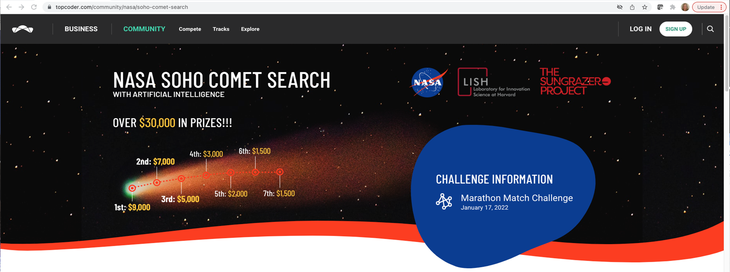
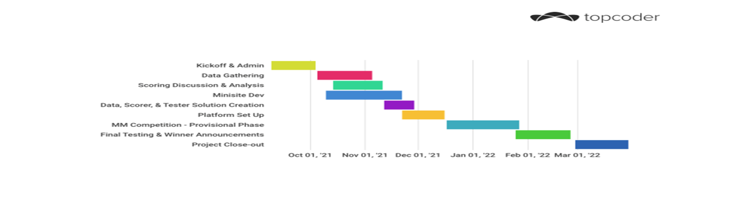

Slide 17
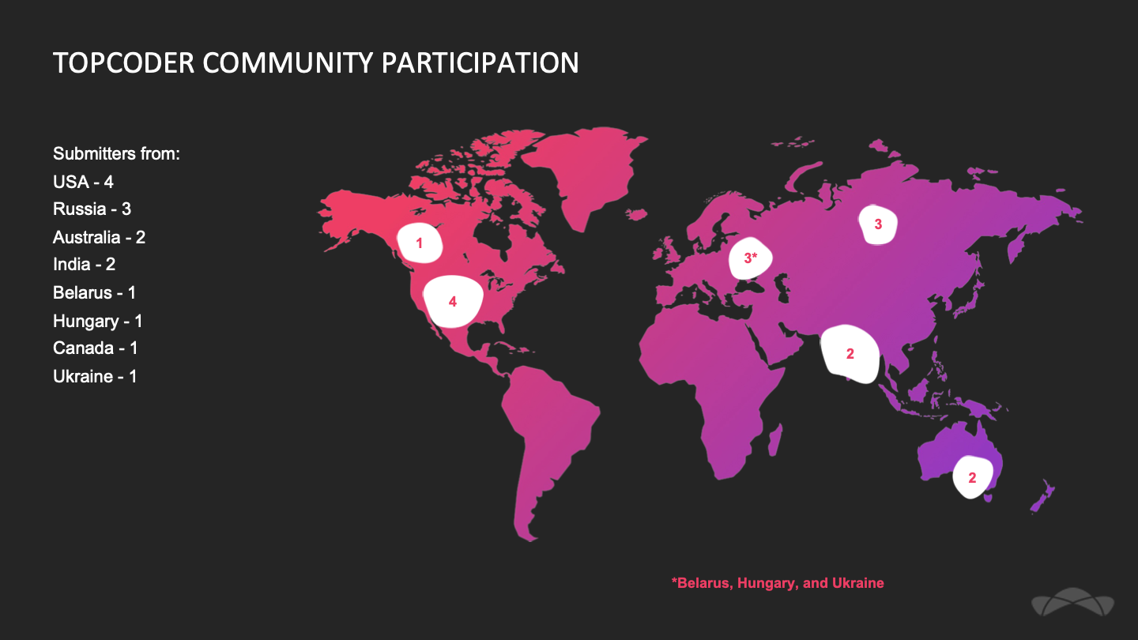
Notable Challenge Statistics
596 people registered (more than 300 new to Topcoder)
74 countries
27 people submitted codes
212 codes submitted
Total prizes $29,000
Top three winners are from USA (gold & silver) and Belarus (bronze)

Slide 18
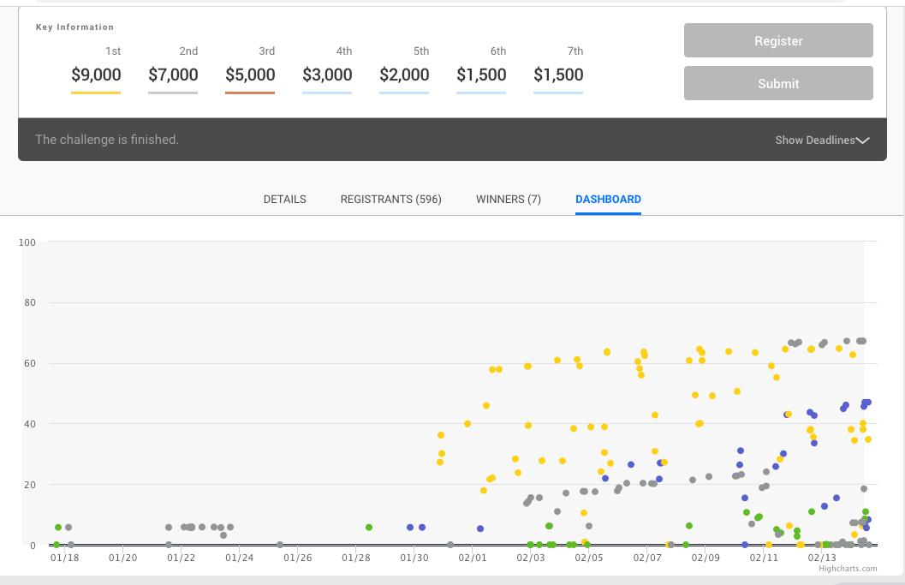
Challenge Dashboard, Final View

Slide 19
Challenge Review Facts
1. Used an algorithmic approach. Requires no training and is very fast.
Final Score: 66.21271, Provisional Score: 67.88644
Training Time: n/a, Testing Time: 38min
2. Used a three-part machine-learning based approach. Quick training time.
Final Score: 62.20877, Provisional Score: 63.24005
Training Time: 24min, Testing Time: 30min
3. Used Deep Learning (DL), Visual Geometry Group with batch normalization (VGG-bn). Long training time, no image preprocessing.
Final Score: 60.41316, Provisional Score: 64.57019
Training Time: 12h 50 min, Testing Time: 1hr 5 min, 4 GPUs
All top 7 submissions will be placed at Gitlab repo: https://gitlab.com/topcoder-consulting/nasa/comet-detection/-/tree/main/
Notes:
1. Software engineer with 12 years professional experience. the author of the Tycho Tracker software, which focuses on the detection and measurement of asteroids, comets, spacecraft, and other moving objects from astronomical images. Had no experience working with data from the Solar and Heliospheric Observatory (SOHO), which proved to offer its own set of challenges.
2. PhD from the University of Kansas working as an experimental particle physicist at the Fermilab accelerator. creating algorithms for identifying various particles produced from beam collisions. this has helped quite a bit with marathon match algorithm development in general. I am interested in NASA and space exploration in general, so being able to work with real data from a NASA space telescope is very exciting. My approach can be divided into three main parts. The first is to perform image preprocessing on the sequence images and obtain a list of comet candidate positions(blobs) from these images. The second is to form comet candidates by matching these blobs across the images. The third is to use machine learning on these candidates to distinguish the true comets from the background. This is the only approach I seriously considered. Given more time, I would've liked to have considered deep learning. 3. A machine learning engineer and a passionate ML/DL competitor. An interesting problem with a large scientific impact vision, considered this problem as a pure DL problem. Instead of simple binary segmentation the targets were pixel wise regression of comet centers. Each comet center was represented as a point with a gaussian filter.

Slide 20
Challenge Results
Seven best AI/ML codes will be placed in GitHub repository for public use
AI/ML ready data will be placed on AWS cloud
New comets possibly discovered (in press, NASA):
May 06, 2005 data, Kreutz-group comet (about 86% of SOHO comet discoveries)
Nov 04, 2016 data, non-group comet, (doesn’t belong to any known comet family). Such comets are only 5% of SOHO’s discoveries )
MINI SITE : https://www.topcoder.com/community/nasa/soho-comet-search
CHALLENGE: https://www.topcoder.com/challenges/fcad16e0-9ca6-4510-8bd9-af3ed026b140

Slide 21
Conclusion/ Questions for Discussion
Description of Project, Sizing Estimates, Data Format, Cloud Provider
Compute Estimates
Period of Support Requested
AWS Services utilized
Can challenge approach be useful for your project or some part of it?
How would you see it?
Let me know if you are interested in serving for AI/ML reviewing meetings
Mail your suggestions to: Ekaterina.M.Verner@nasa.gov

Slide 22
Questions?

Slide 23
#HelioRocks!

Slide 24
Backup Slides

Slide 25
What We Asked The Crowd For
Develop an Artificial Intelligence (AI)/Machine Learning (ML) tool that will help astronomers detect very faint comets that approach the sun, referred to as “sungrazing comets.”
●Python
●Run on a p3.8xlarge Linux AWS EC2 instance
●Output in CSV
●Output includes [{x},{y}] and are real values in the [0,...,1024] range, representing the coordinates of the center of a detected comet on the given image
●Output file must not contain more than 5000 lines
●The same image-id must not appear more than once in the same line.
●5 images in a sequence must have a comet to count as a “positive” detection
●Noise reduction and image preprocessing parts of the system are sufficiently isolated (i.e. into their own class, module, set of functions, etc.) and well documented
No requirements were changed as a result of forum questions. The following are clarifications we provided based on questions:
●Clarification on behavior of stars/planets in data
●Clarification about conditions in which the spacecraft was “rolled”

Slide 26
Artificial Intelligence and Machine Learning
Supervised learning A (INPUT)→B (OUTPUT) e. g. translation, visual inspection
Most growing area
Large Neural Net
Medium Neural Net
Small Neural Net
Performance
Traditional AI
Amount of Data
Big Data

Slide 27
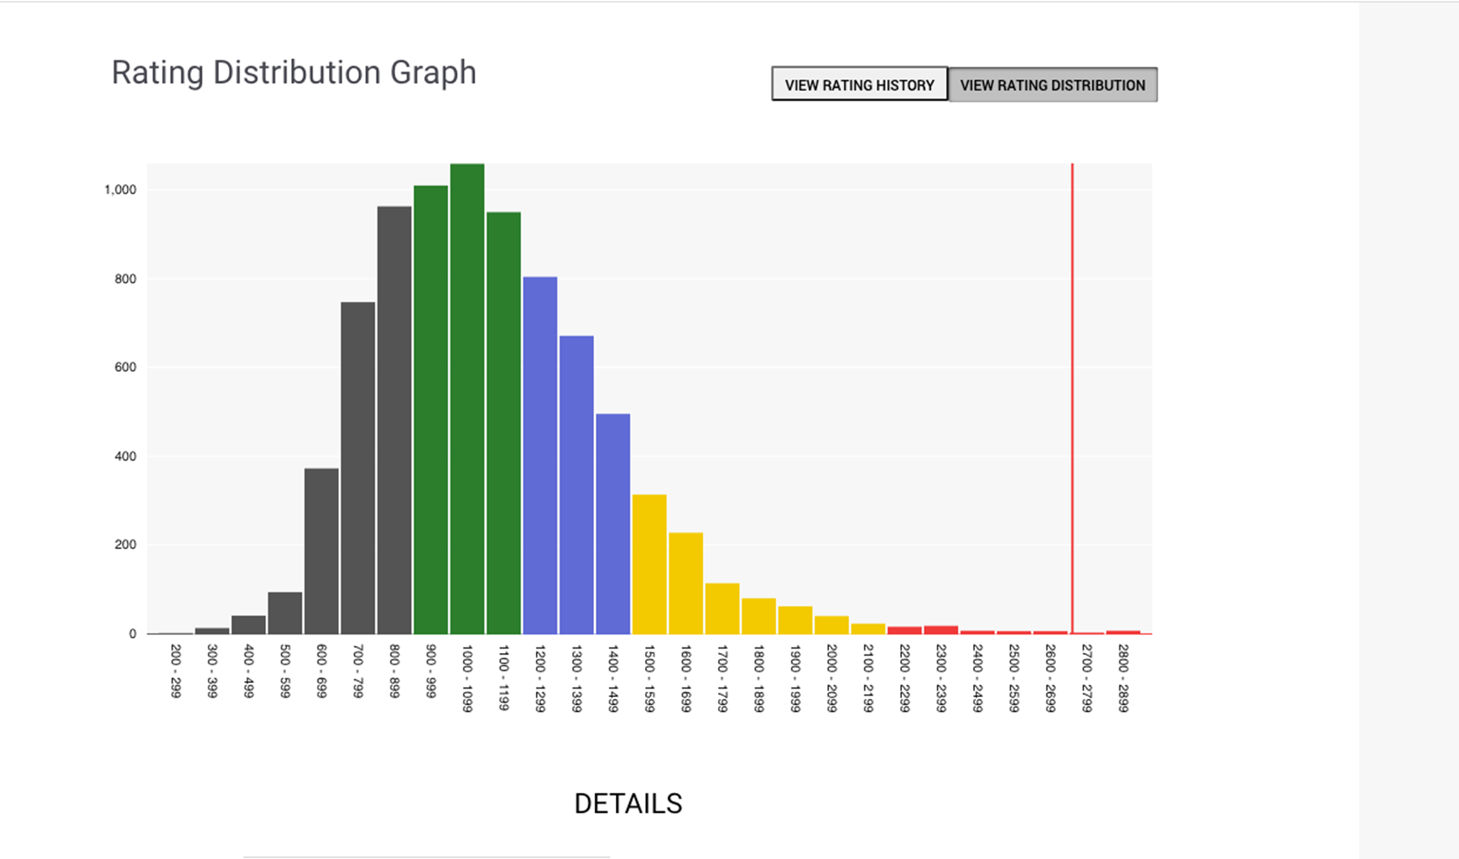

Slide 28
Heliophysics Division Looking Ahead
Confirmation in 2021-22: HERMES, TRACERS, Solar Cruiser, GLIDE, EZIE
Down-select Medium Class Explorers (MIDEX-19)
Continue pre-formulation activities ahead of DYNAMIC mission
Maintain healthy Research and Analysis Program
Early Career Investigator Program cadence every 2 years
Support robust suborbital program, including CubeSats
Maintaining DRIVE initiative and prepare for selection of 2 DRIVE Science Centers in early 2022
Enhance the scientific return by innovatively connecting observations from one or more missions with satellite or ground observations from other Divisions, and/or other agencies within or outside the U.S. (HSO Connect, Daniel K. Inouye Solar Telescope, etc.)
Continue planning for 2023 Decadal Survey (mission concepts, conversations with NASEM, NSF, and NOAA)
Implement IDEA actions into the Heliophysics strategy
Support early and mid-career individuals through roundtables and a robust support network

Slide 29
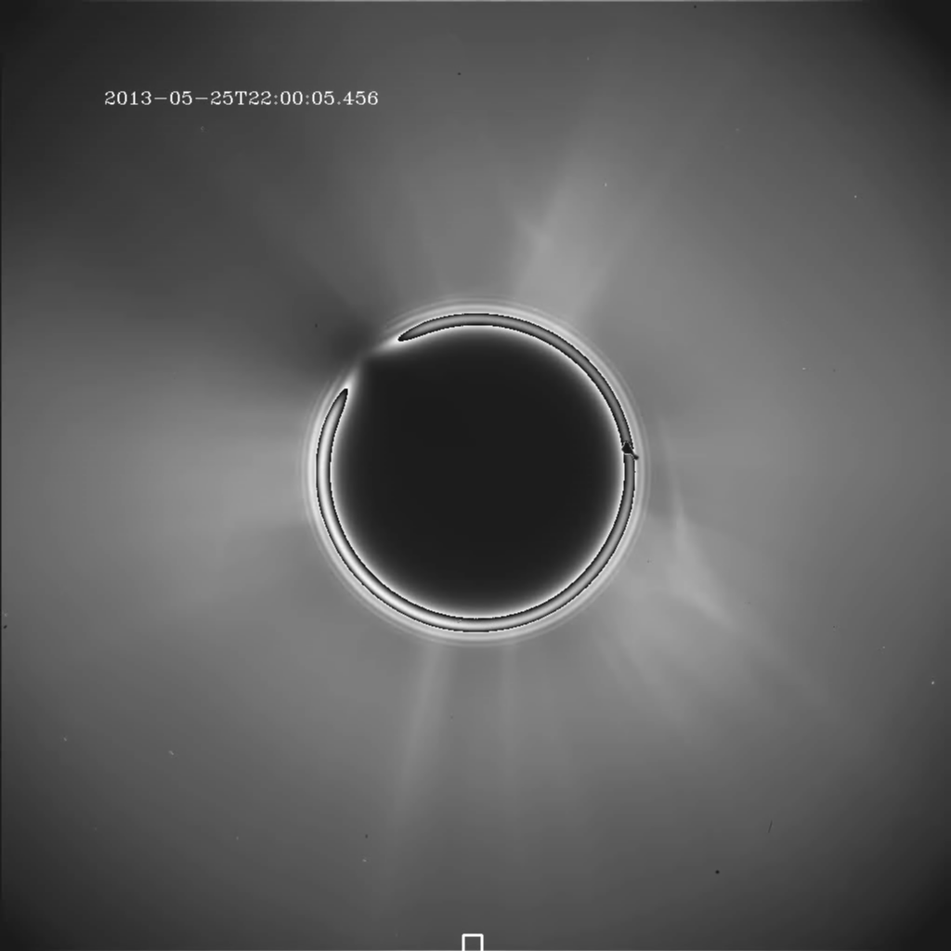
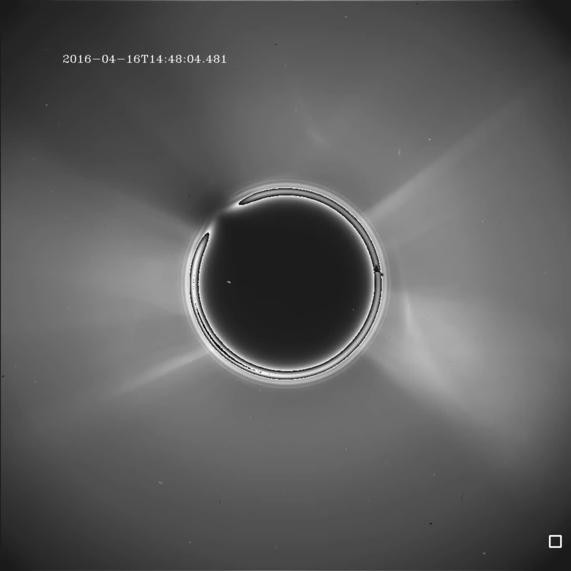
AWS Effort: AI/ML Comet Identification (with IOU)
A
B
C

Slide 30
B.3 H-TMS
Step 1 12/15/2022
Step 2 03/14/2022

Slide 31
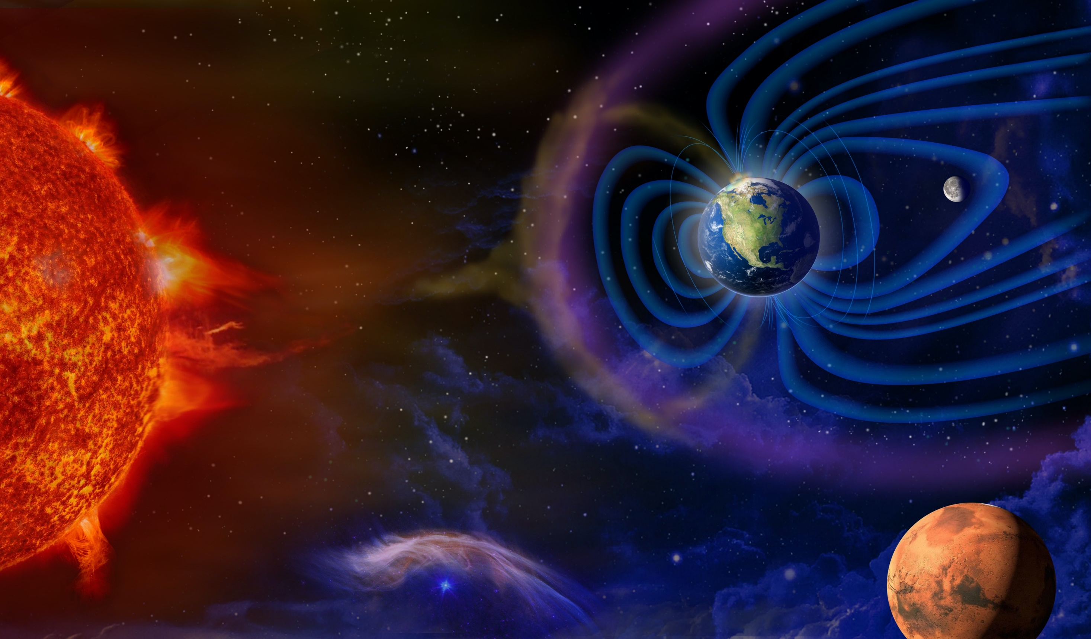
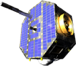

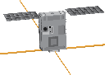
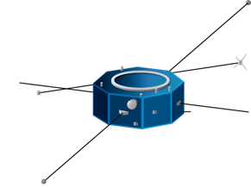
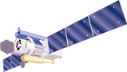
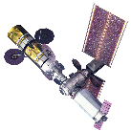
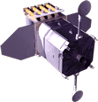

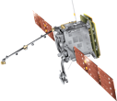
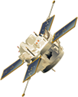
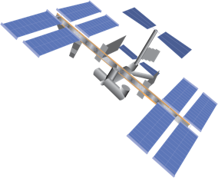
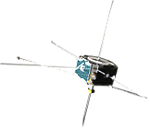
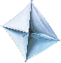
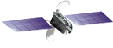
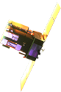
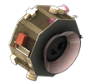
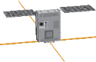
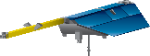
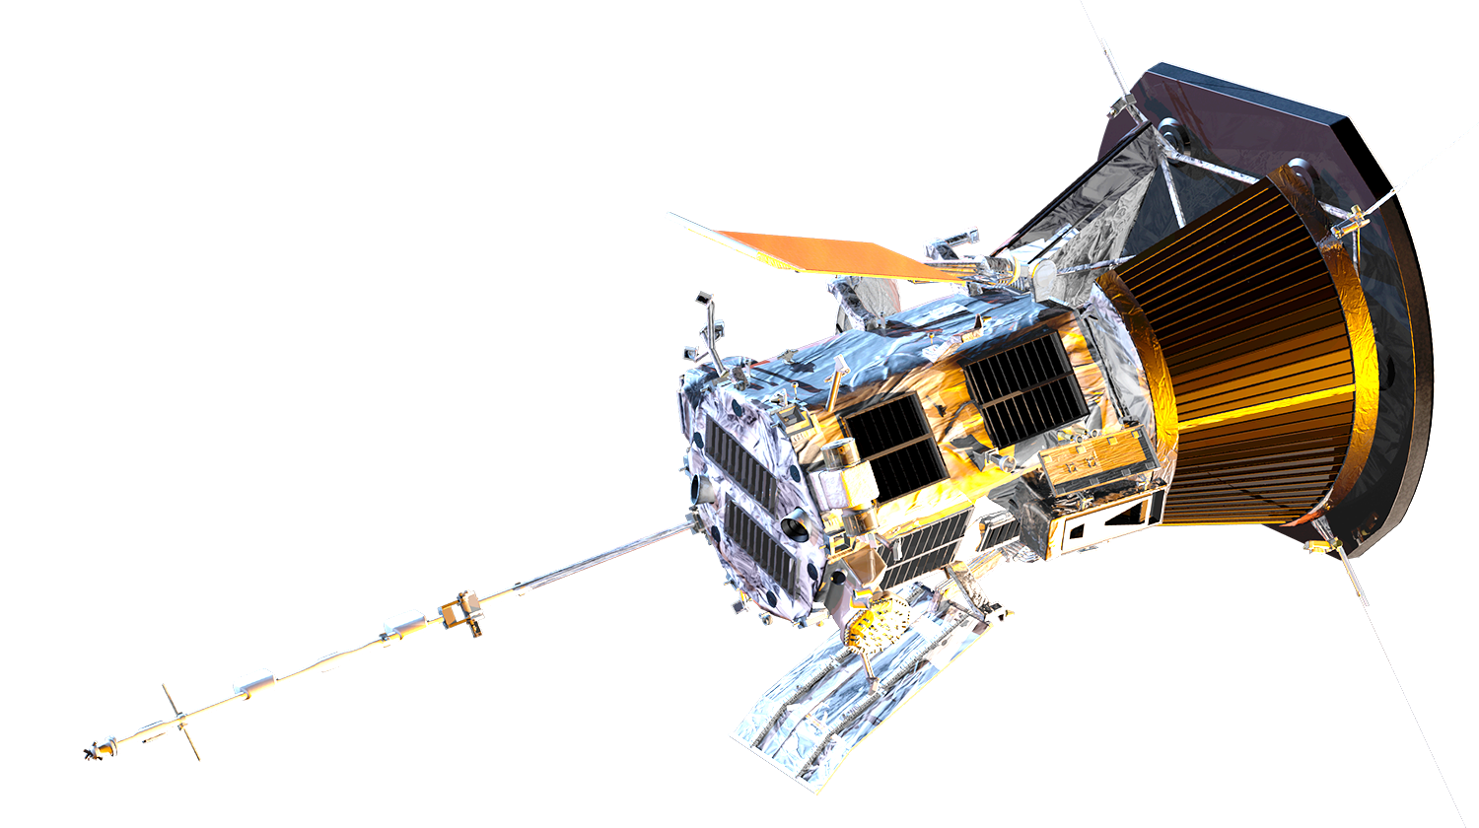
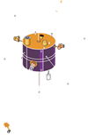
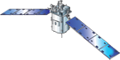
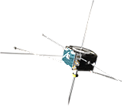

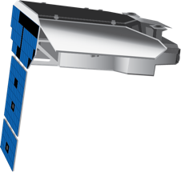
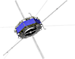
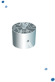
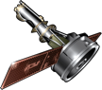
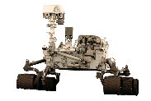
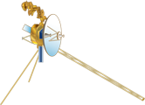
HELIOPHYSICS SYSTEM OBSERVATORY
IBEX
20 Operating Missions with 27 Spacecraft
12 Missions in Formulation or Development
6 Under Study
AIM
SunRISE (6)
TRACERS (2)
EUVST
(JAXA)
HERMES (Gateway)
SDO
ICON
Solar Orbiter (ESA)
ACE
AWE (ISS)
Solar Cruiser
THEMIS-ARTEMIS (2)
GOLD (SES)
SOHO (ESA)
IMAP
Parker Solar Probe
WIND
GDC
EZIE (3)
TIMED
GLIDE
PUNCH (4)
THEMIS (3)
FORMULATION
STEREO
IMPLEMENTATION
Hinode (JAXA)
MMS (4)
PRIMARY OPS
Geotail (JAXA)
EXTENDED OPS
IRIS
CubeSats
In Development
AEPEX
AERO / VISTA
CIRBE
CODEX
CuPID
LAICE
LLITED
MinXSS-3
petitSat
REAL
SPORT
On Orbit
ELFIN
SORTIE
RAD
CURIE
CuSP
DAILI
Dione
GTOSat
ESCAPADE (2)
Voyager (2)
OPERATING & FUTURE
Notes:
Operating
Solar Orbiter (2020)
ICON (2019)
Parker Solar Probe (2018)
GOLD (2018)
MMS (2015)
IRIS (2013)
SDO (2010)
IBEX (2008)
AIM (2007)
THEMIS (2007)
THEMIS+ARTEMIS (2007)
STEREO (2006)
Hinode (2006)
TIMED (2001)
ACE (1997)
SOHO (1995)
Wind (1994)
Geotail (1992)
Voyager 1+2 (1977)
RAD
Formulation or Development
SunRISE
PUNCH
TRACERS
MAGIC
EZIE
EUVST
IMAP
Solar Cruiser
HERMES
GDC
GLIDE
ESCAPADE
Under Study
ARCS (MIDEX-19)
MUSE (MIDEX-19)
STORM (MIDEX-19)
HelioSwarm (MIDEX-19)
Solaris (MIDEX-19)
DYNAMIC

